Slide 1

Predicting Tech Layoffs
Kerry Effinger

Slide 2
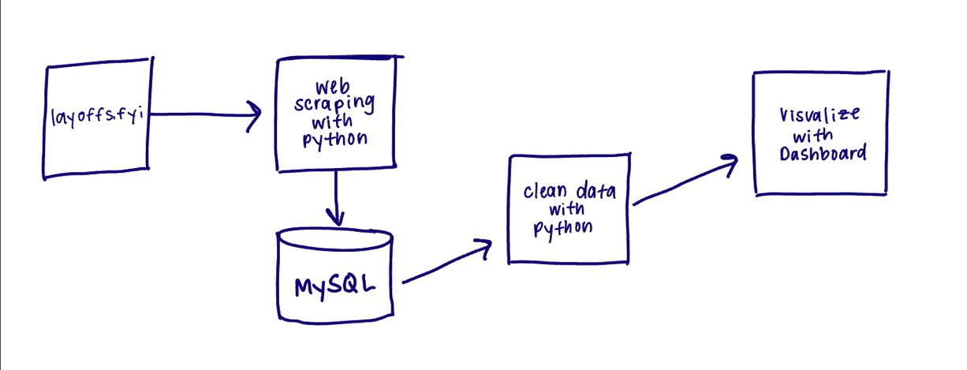
Proposal
goal is to uncover the common attributes of companies who have conducted major layoffs
data from past layoffs will be used to create a model to predict future layoffs
Predictive analysis

Slide 3
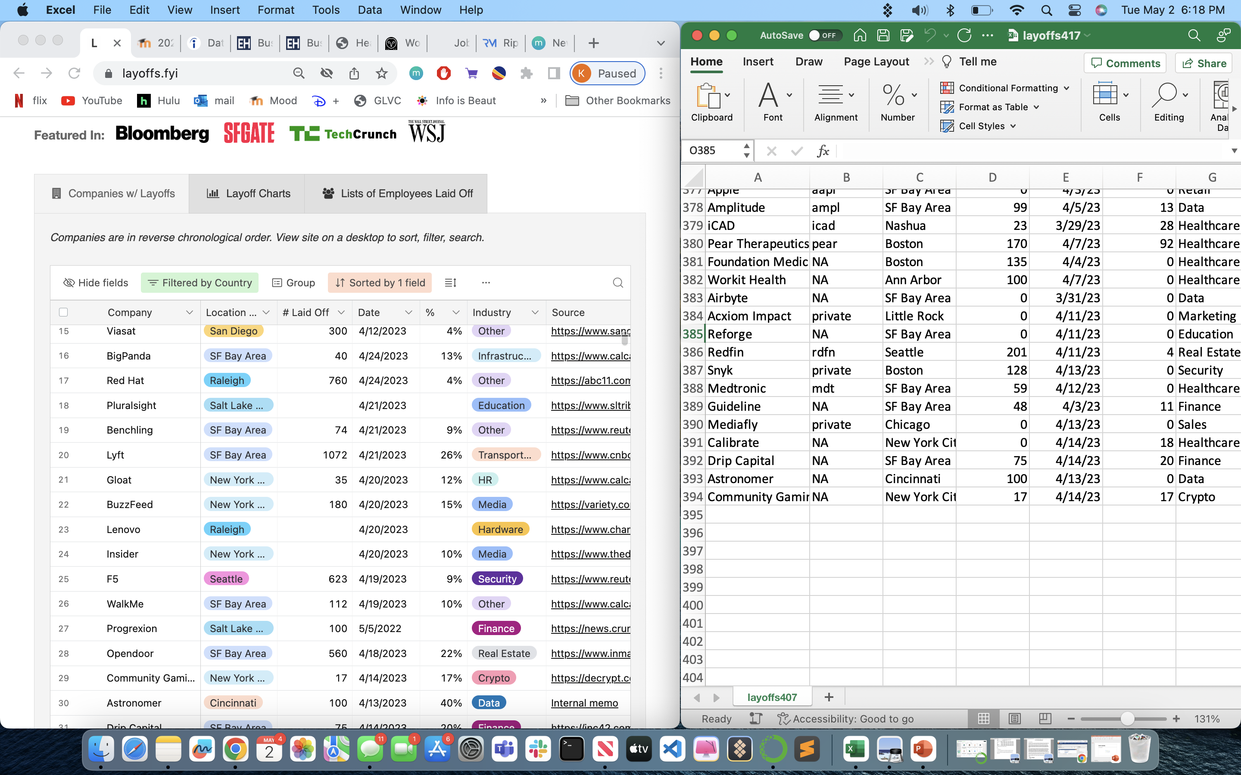
Data Collection

Slide 4
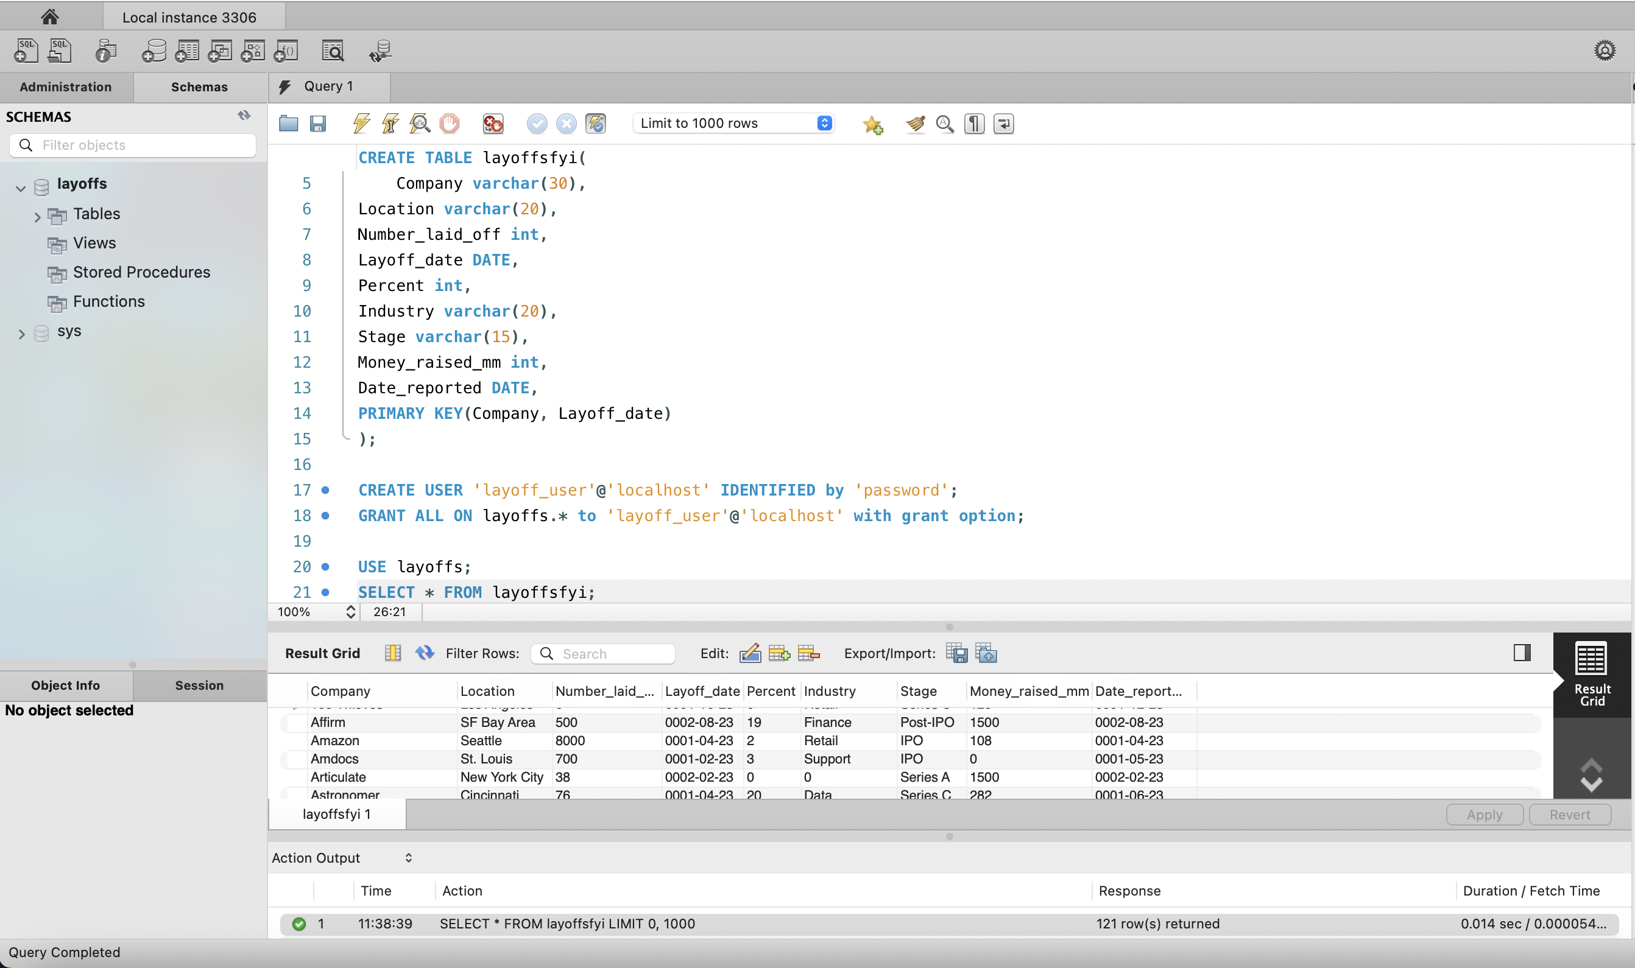
Data Storage

Slide 5
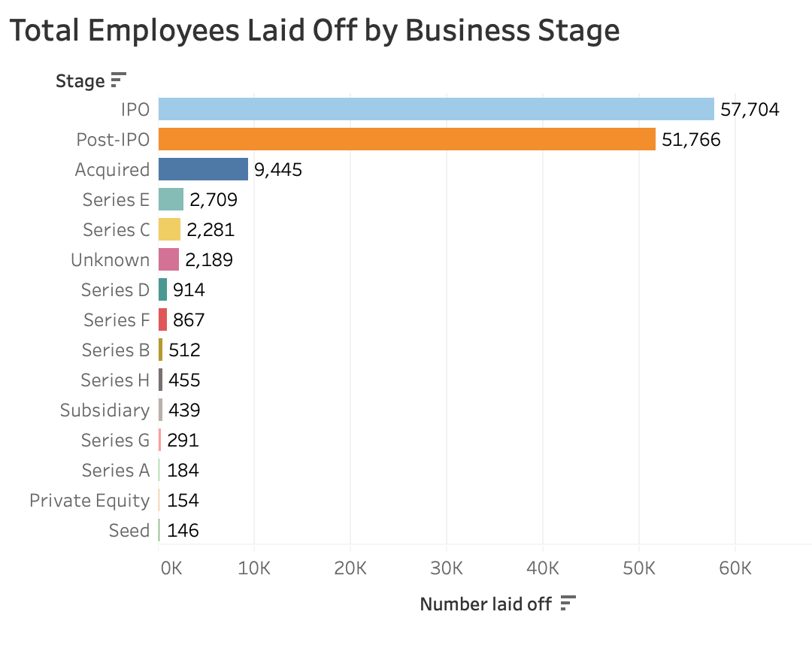
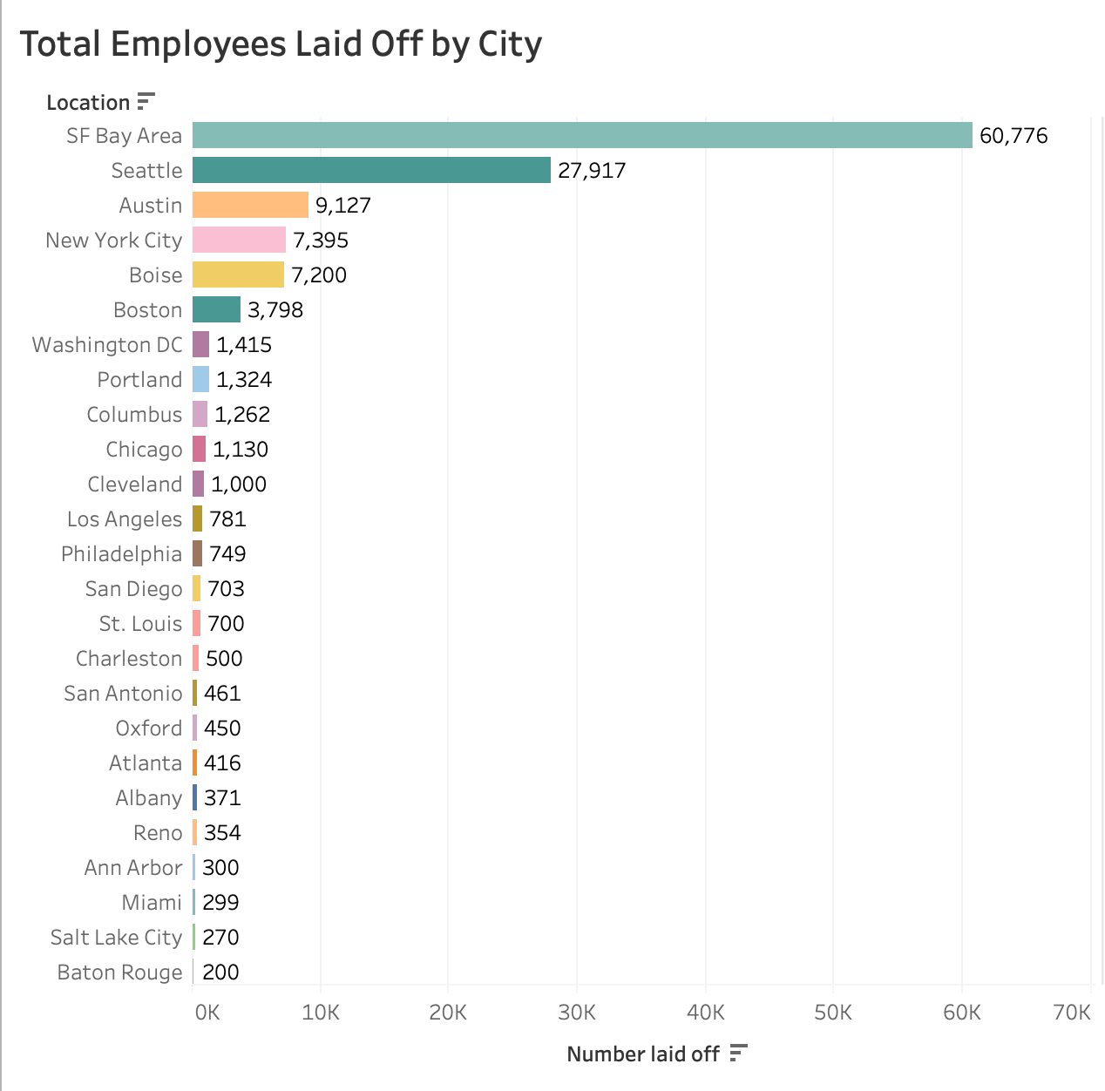
Exploratory Data Analysis

Slide 6
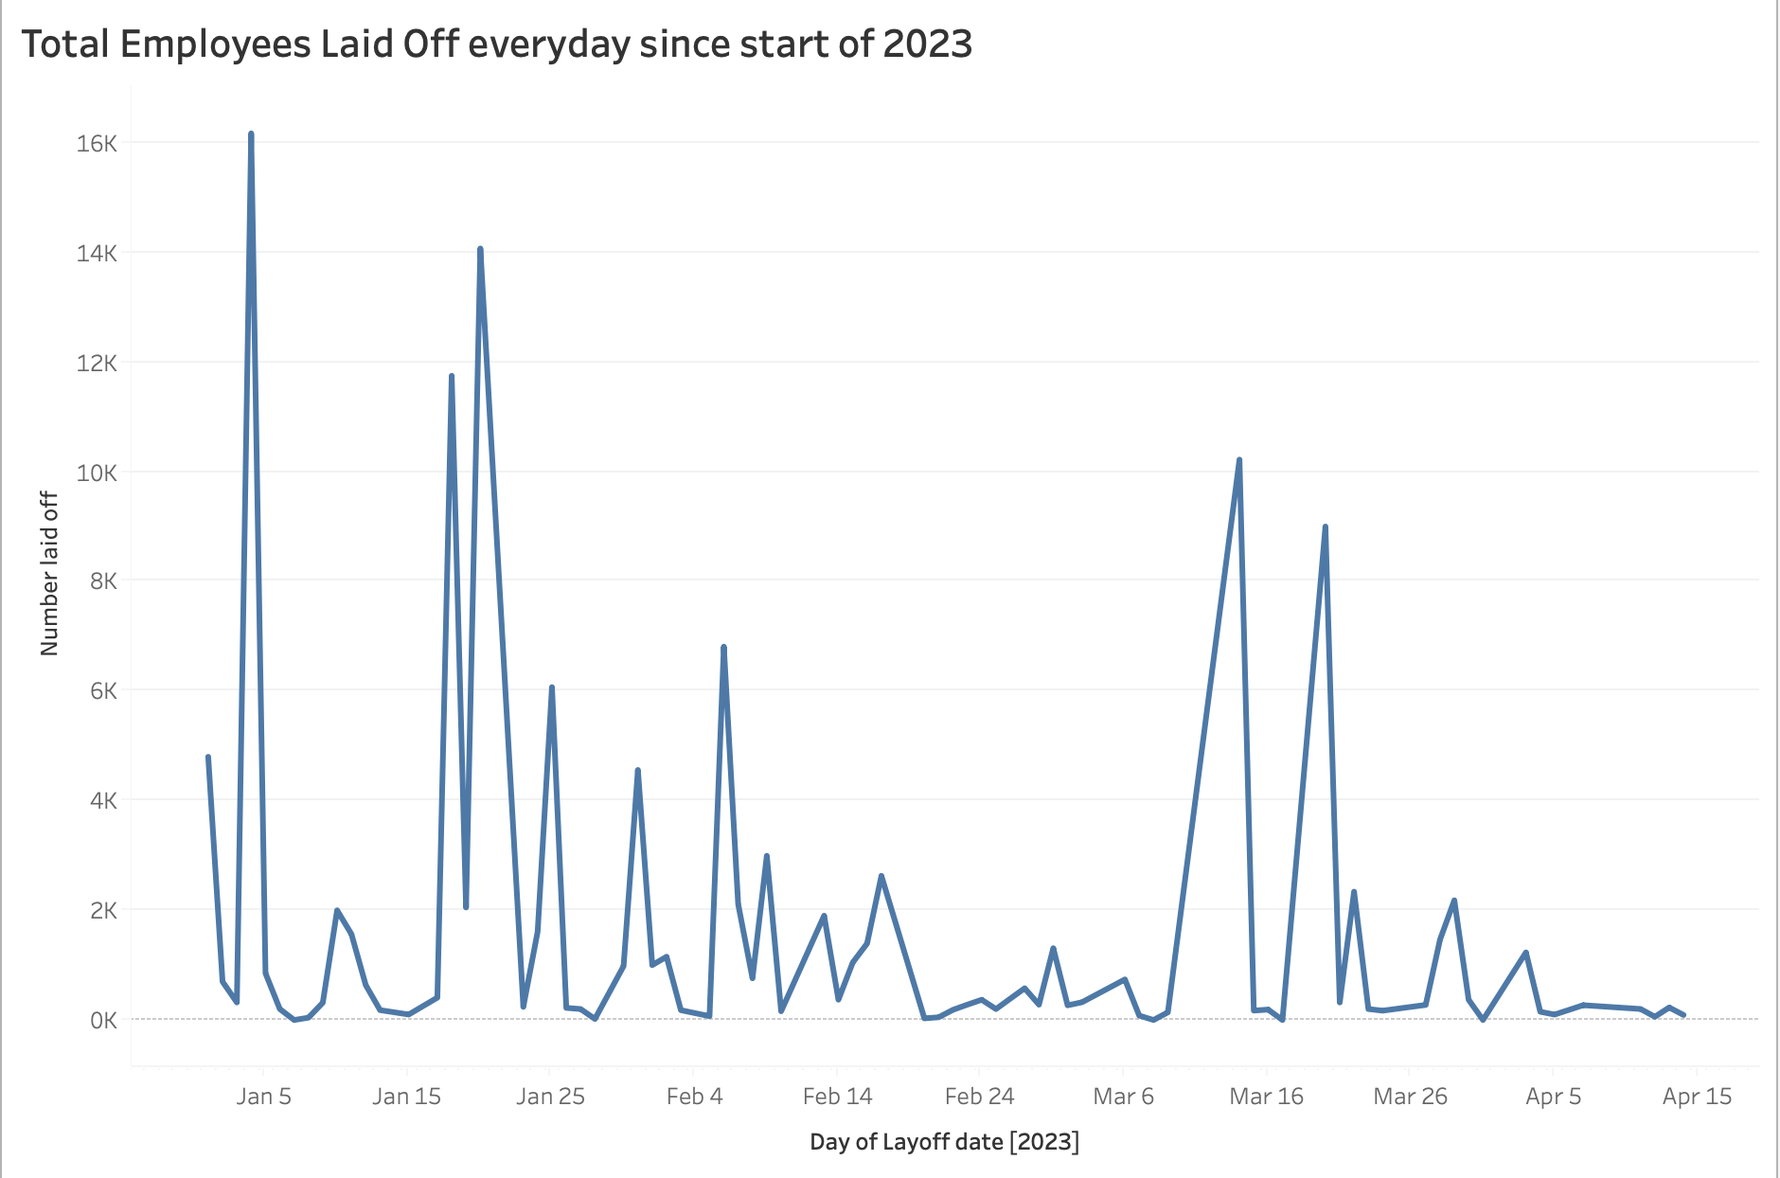
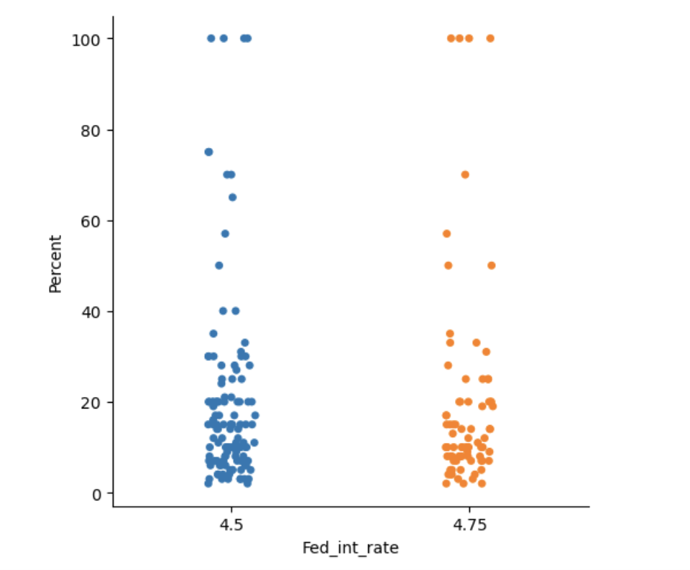
Exploratory Data Analysis
Percent of Employees Laid off and Interest Rates

Slide 7
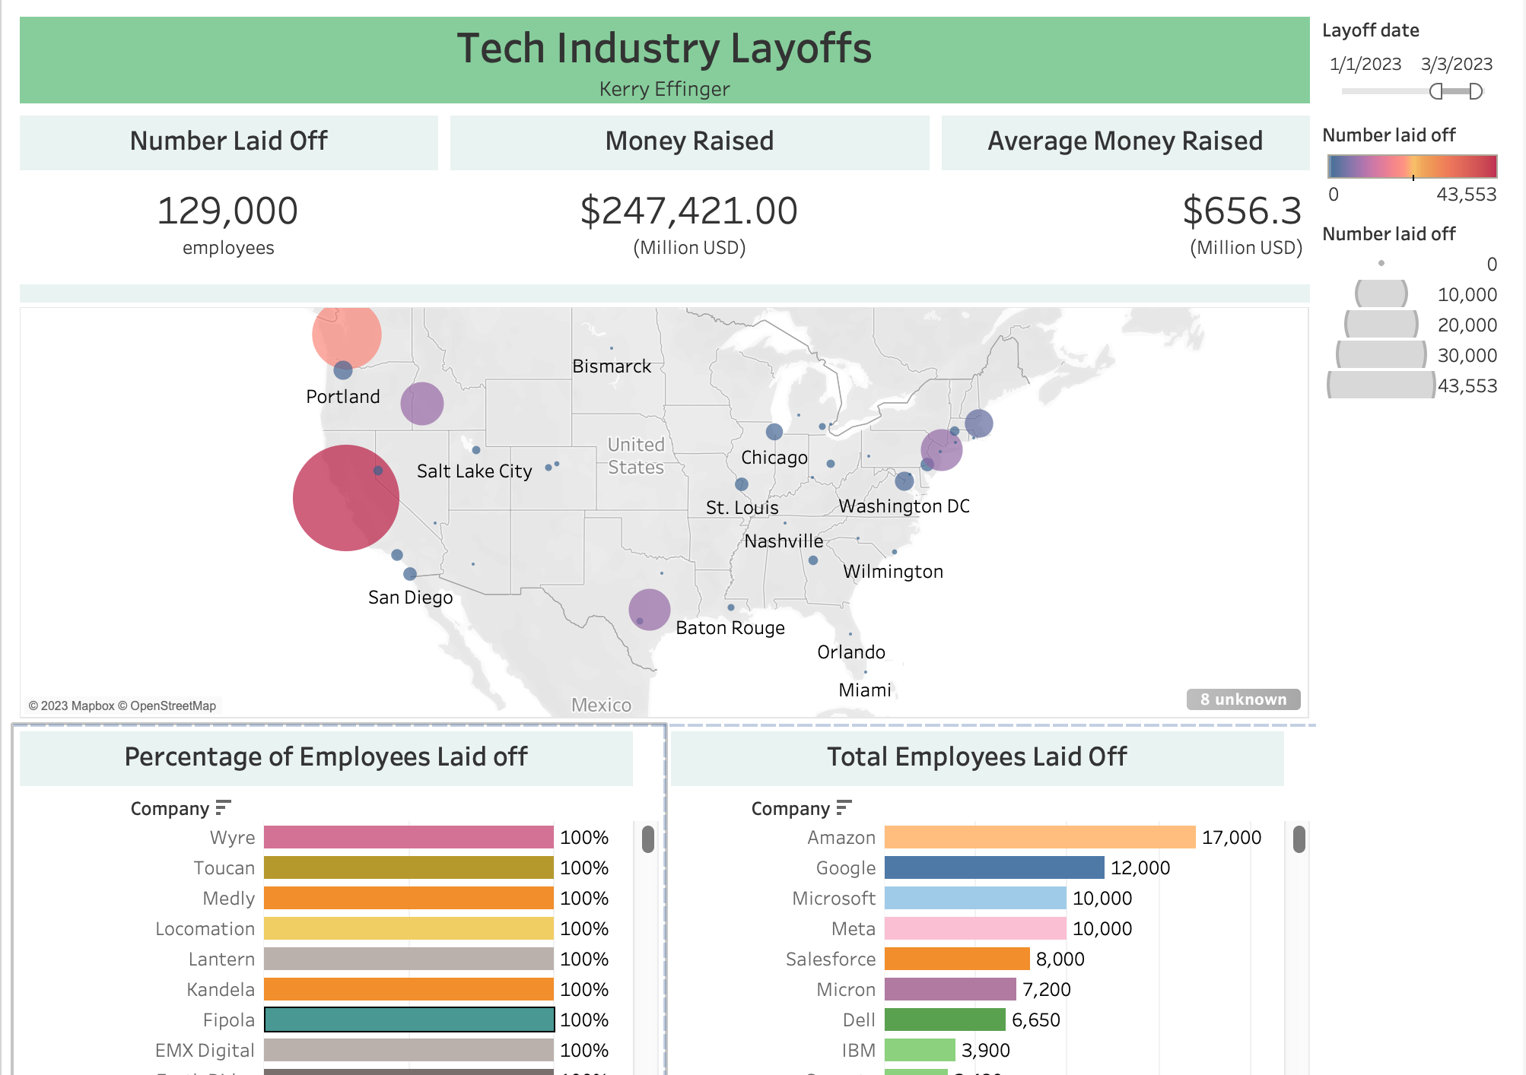
Dashboard

Slide 8
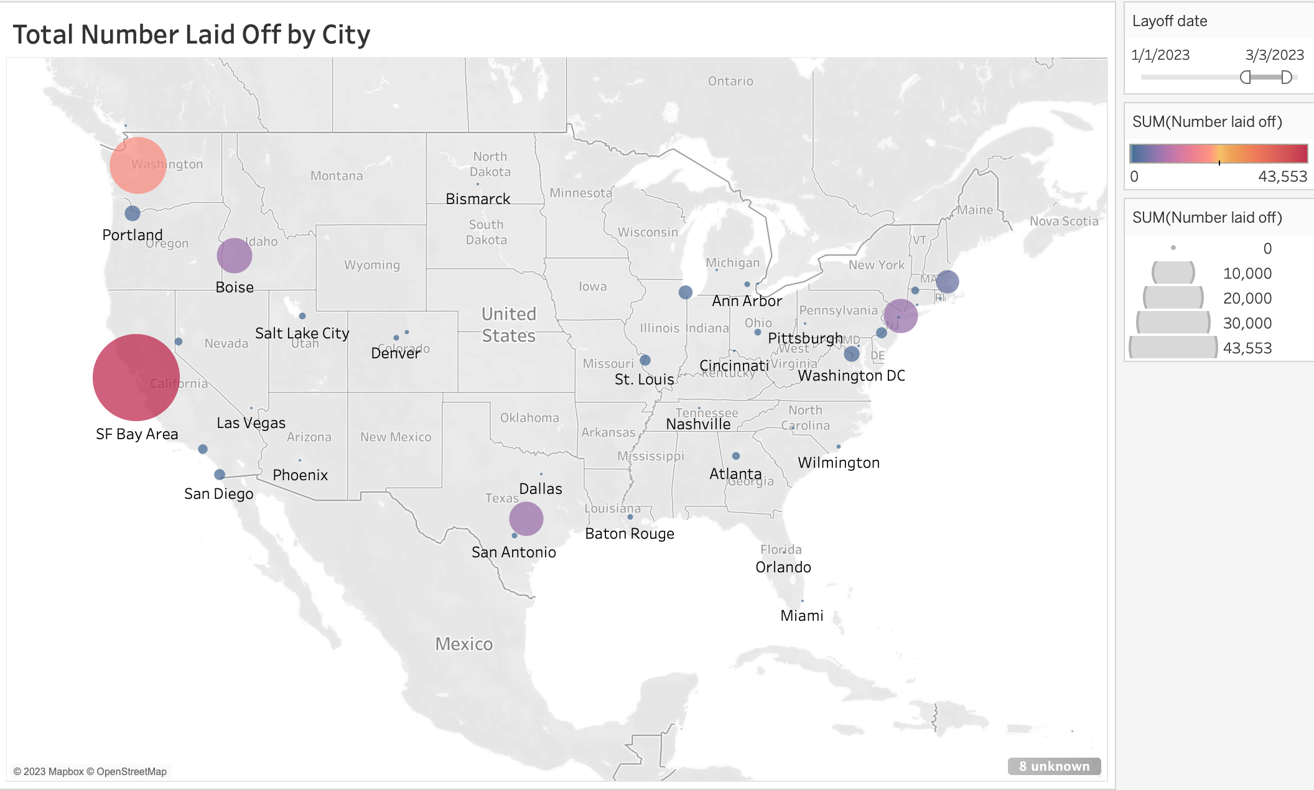

Slide 9
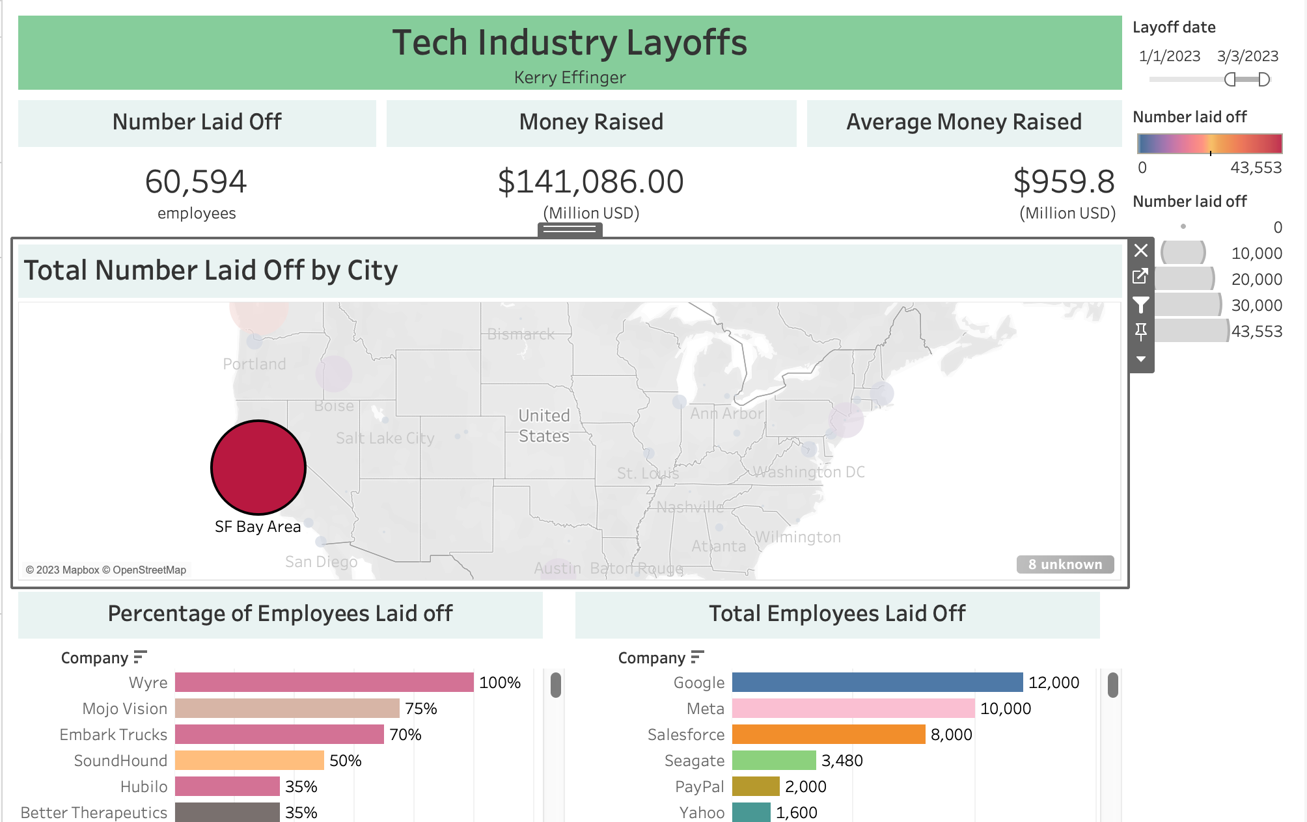
Dashboard (SF Bay Area)

Slide 10

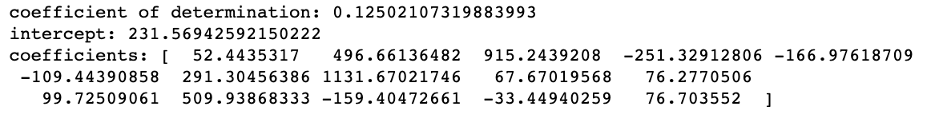
Linear Regression Model
Regress Number Laid off on location, industry, business stage and federal interest rate
Since all explanatory variables were categorical, they were transformed into dummy variables (with 1 for true and 0 for false) to use for the model

Slide 11
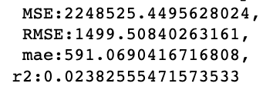
Model Results
MSE, RSME and MAE values are all very high for the linear model.
Predicting values with this linear regression model will not yield accurate predictions
Missing values were filled with the average of the remaining data for the sake of the model; a different model may yield better results.

Slide 12
Reflections
Struggled with: web-scraping, MySQL Workbench, finding financial data, missing data, predictive model, time
What went well: topic and data discovery, EDA, MySQL and Python connection, Tableau dashboard, poster presentation
What I would change: collect data sooner, collect data from 2022 (to have larger dataset), filter for IPO (public companies), make logistic regression model (would need to collect different data)

Slide 13
Summary
Learned about the nature of tech layoffs in the country since the start of 2023
Successfully collected, analyzed and visualized dataset
Unsuccessfully created a predictive model, though have ideas on how to potentially make a better model
Learned several new data science skills!

Slide 14
Questions?

